Slide 1
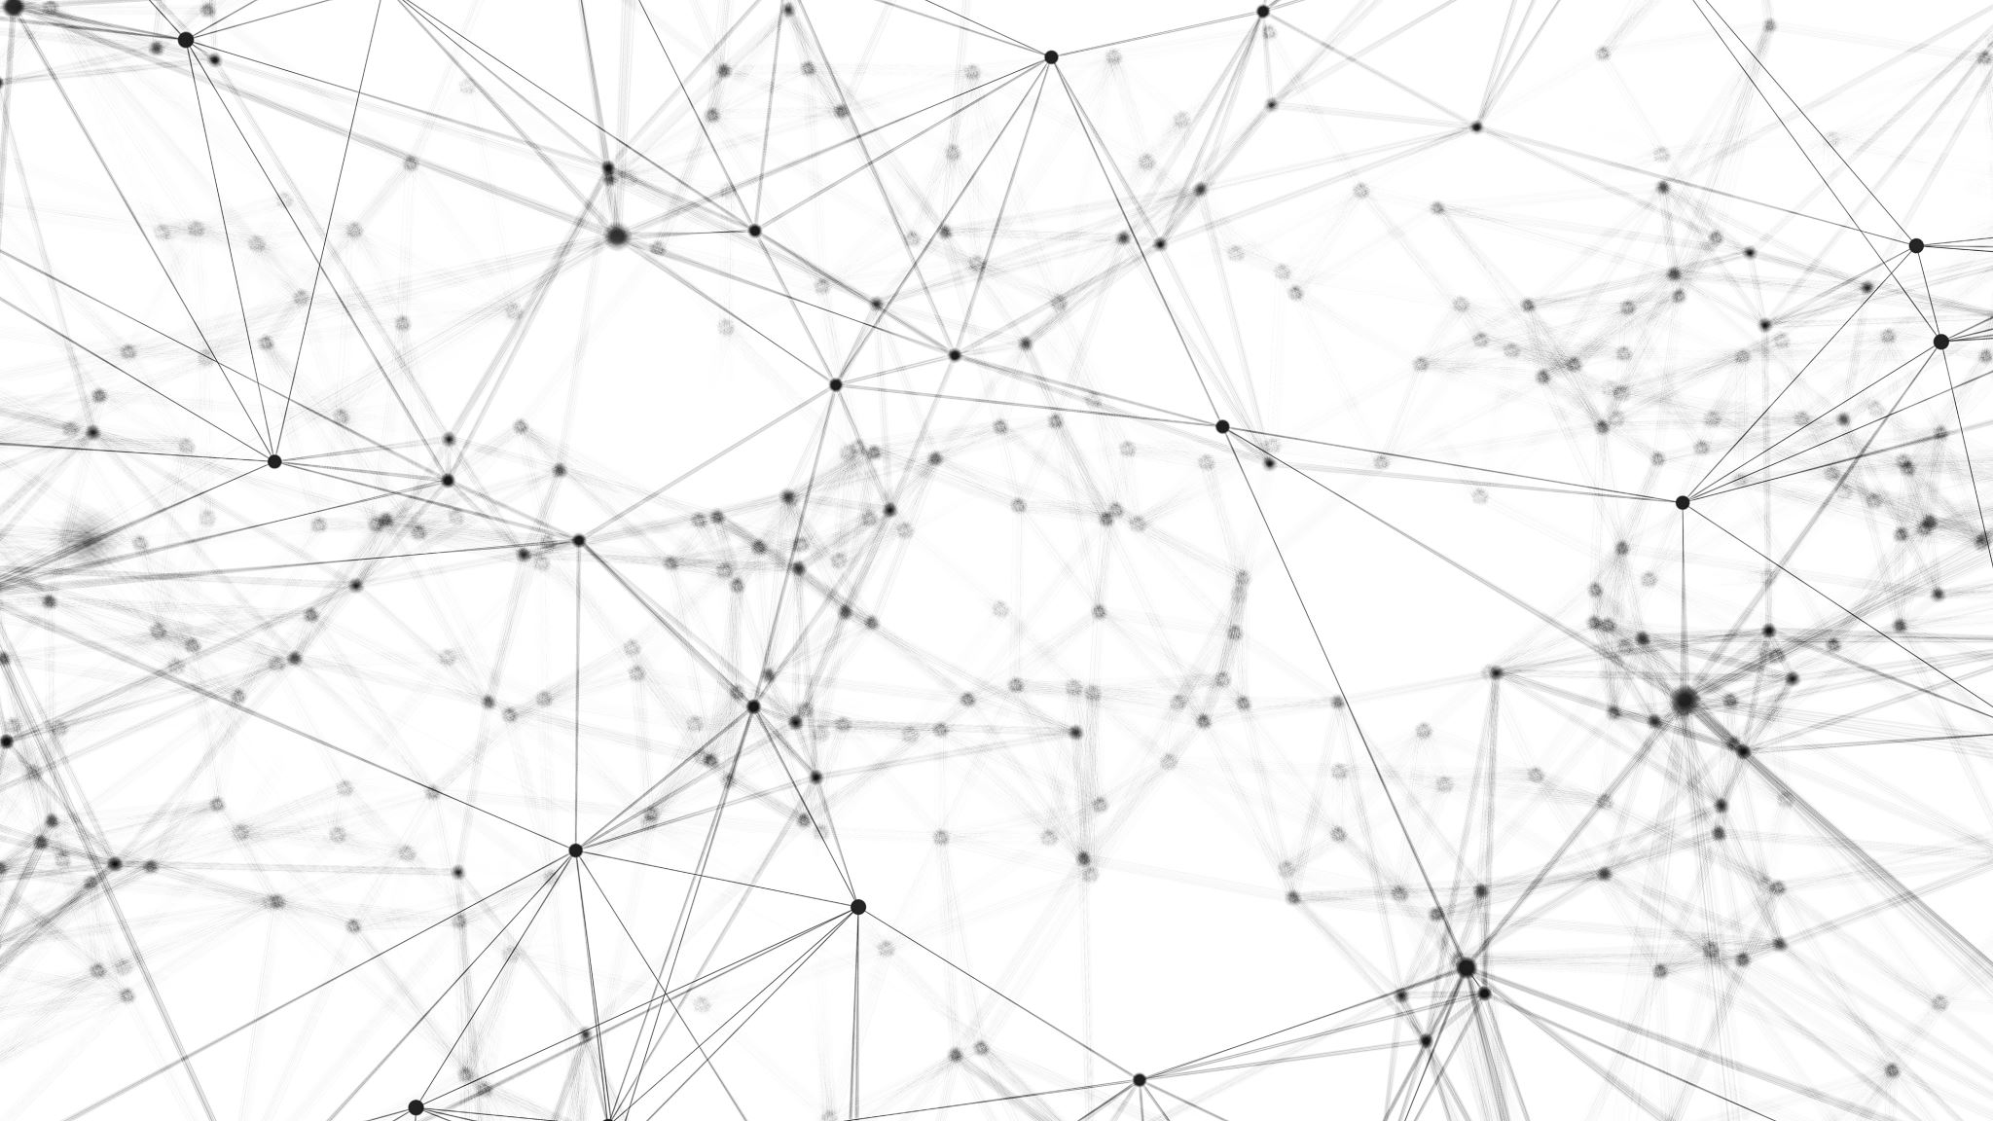
Power and Bandwidth Allocation in Multibeam Satellite Systems

Slide 2
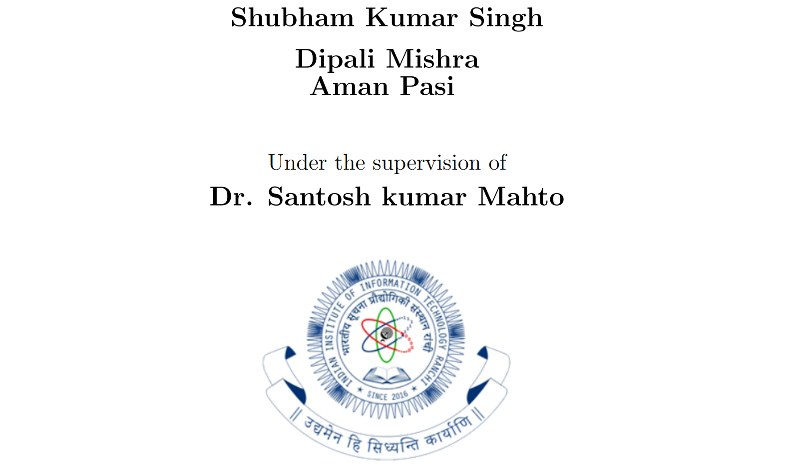

Slide 3

Content
Introduction
System Model
Genetic Algorithm
Future Work

Slide 4

Introduction

Slide 5

Dynamic Resource Management
Notes:
New generations of communications satellites will provide hundreds of Gbps of throughput by using advanced digital payloads, which will allow for
1. beam-steering
2. beam-shaping
3. individual allocation of power and bandwidth for each beam.
Therefore, dynamic resource management (DRM) techniques for communications satellites will be crucial for operators to fully exploit the capabilities of their satellites.

Slide 6

Our Goal
Notes:
Our goal is to presents a method for joint power and bandwidth allocation in multibeam satellite systems.
To that end, we first develop a multibeam satellite model that accounts for
1. propagation effects,
2. interference among beams,
3. and atmospheric attenuation.
Next, we formulate the joint power and bandwidth allocation optimization problem, whose basis is hybrid genetic algorithm.
We'll propose a pythonic model to solve this problem.

Slide 7

Spot Beam Satellite
Most Significant advancements leading to increase in capacity in modern satellite.
In a spot beam the signal power is focused on a specific area of the Earth’s surface, being the beam’s footprint on the order of several hundreds of kilometers

Slide 8
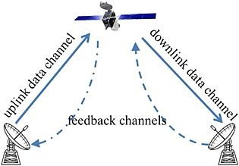
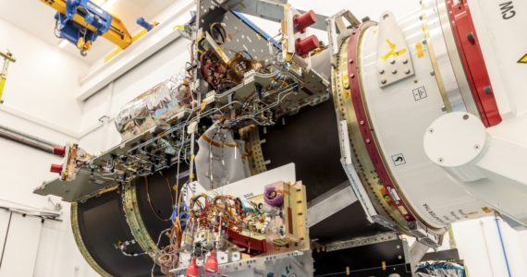
Transition
Notes:
operators are transitioning from rigid bent-pipe architectures towards flexible and reconfigurable satellite architectures.
In newer designs analog payloads are replaced with digital payloads, which allow for dynamic on-demand resource allocation

Slide 9
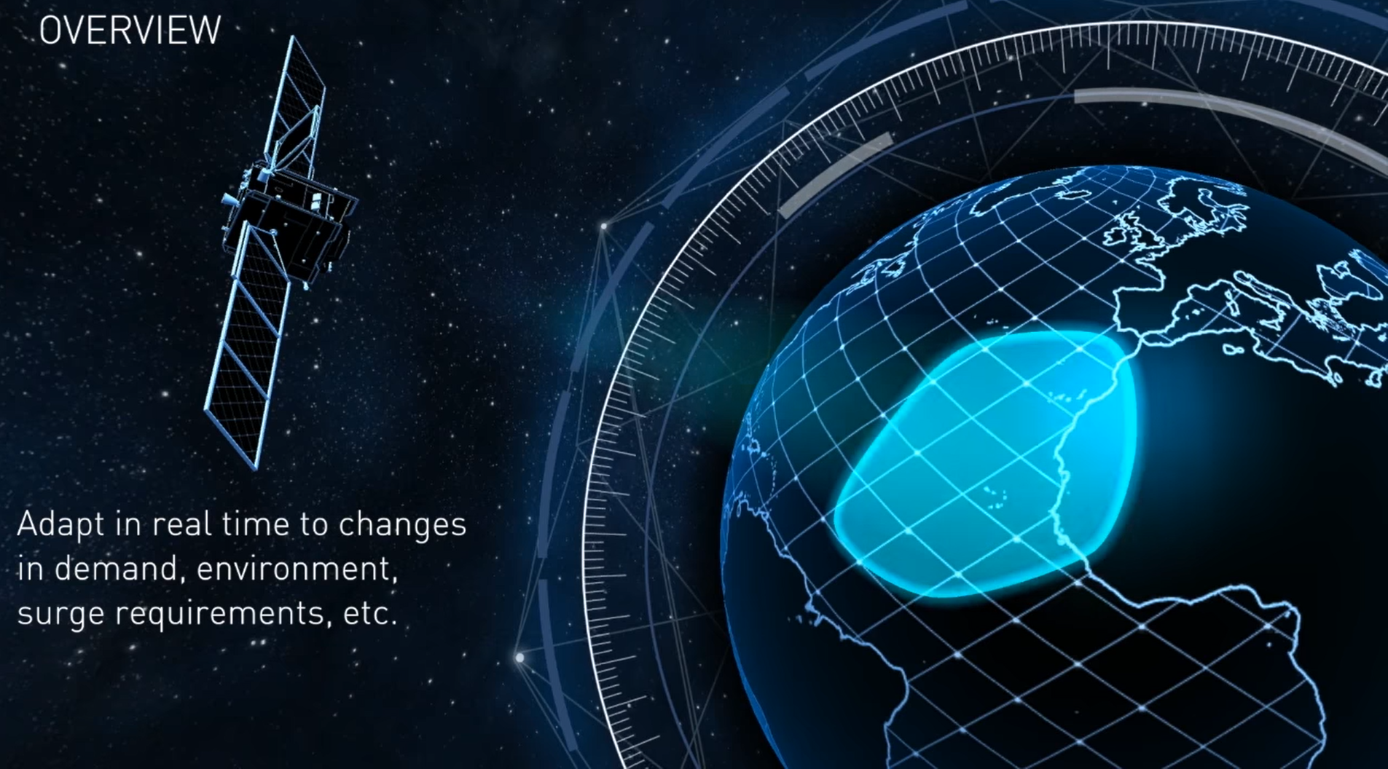
Notes:
https://youtu.be/0iKgOahW5y0

Slide 10
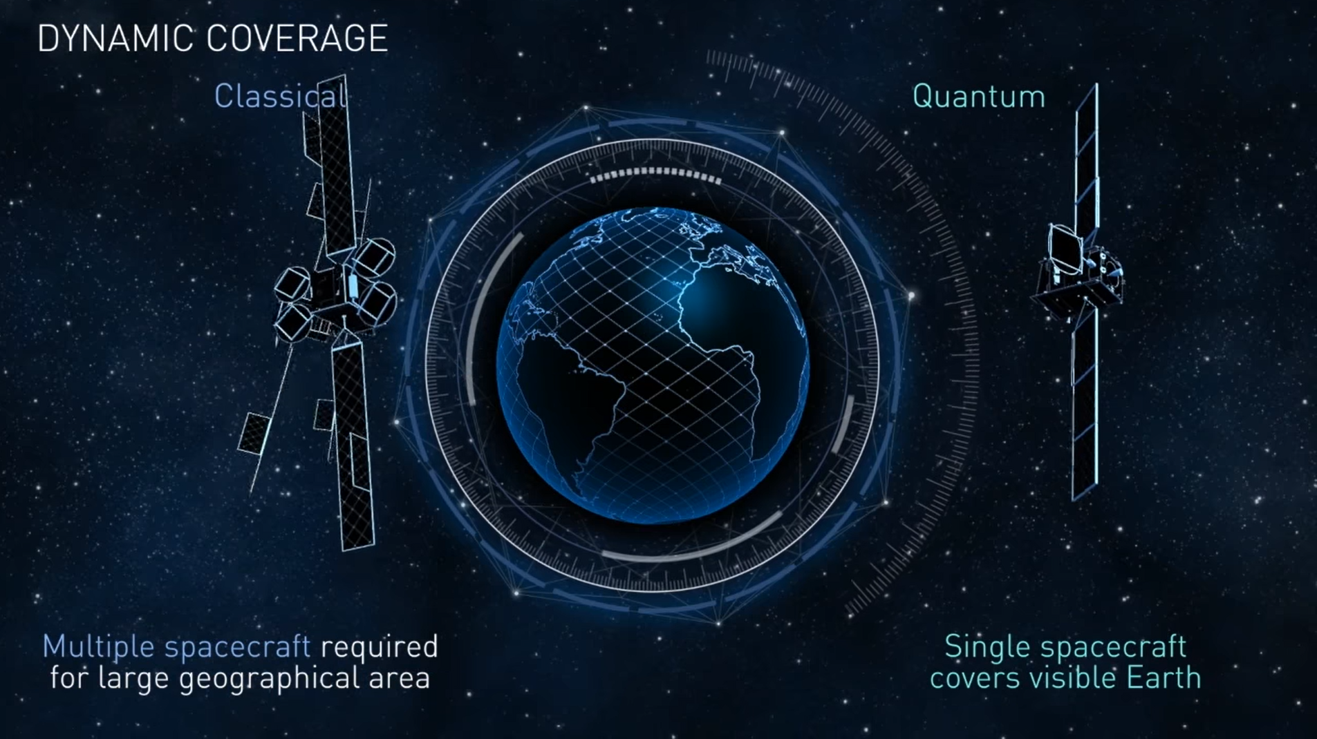

Slide 11
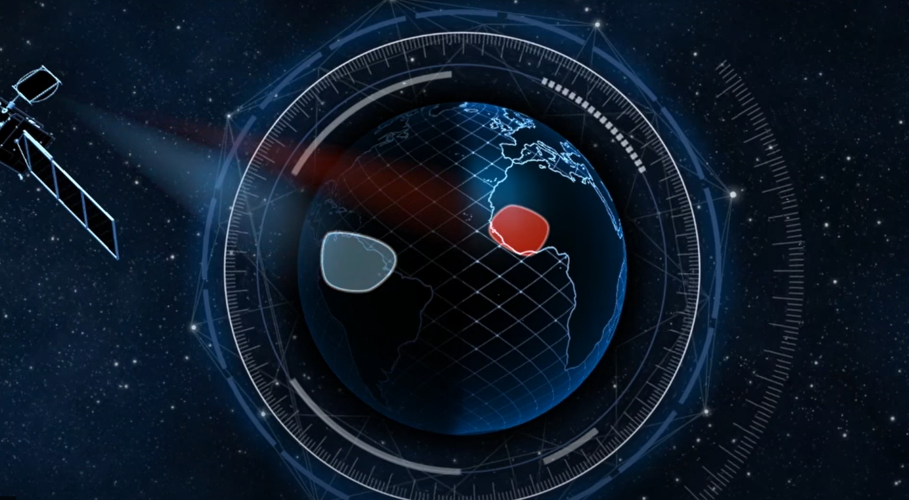

Slide 12

System Model
Notes:
For this project we have worked on Link Budget Model. The other models that you can find are
1. Interference Models
2. Atmospheric Attenuation Model

Slide 13
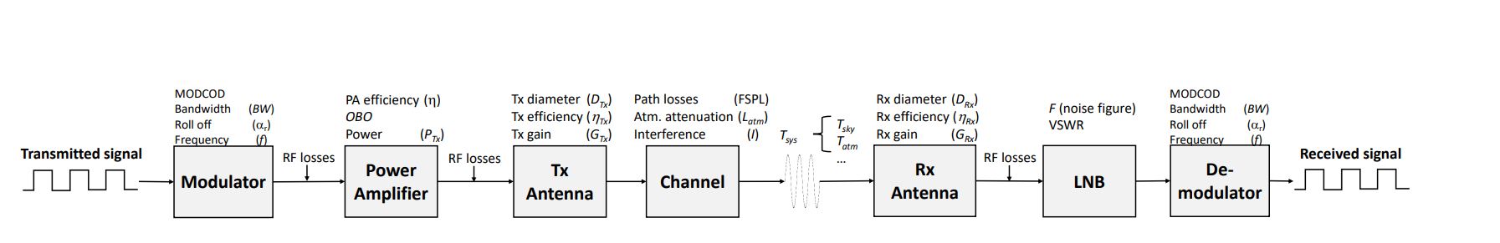
Link Budget Model

Slide 14
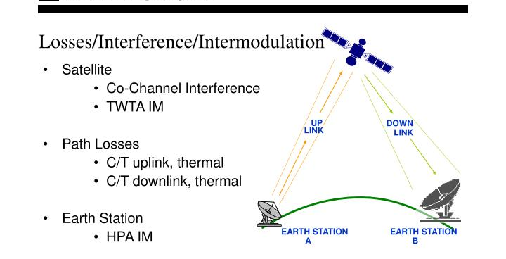
Notes:
Link budget equaltion is used to compute the achievable date rate for each of the beams.

Slide 15

Link Budget Equaltion
We have used 6 Equation to compute the link
Calculation of Signal to Noise Ratio (SNR)
Calculation of Loss due to atmoshphere and other factors
System Tempreature
Calculation of Signal to Interference plus Noise Ratio (SINR)
Energy per bit to Noise + Interfernce Ratio
Beam Data Rate

Slide 16
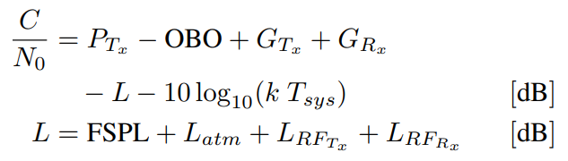
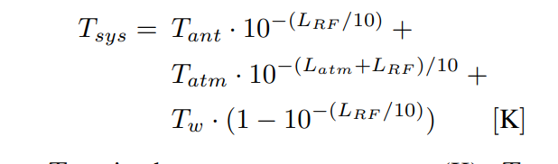
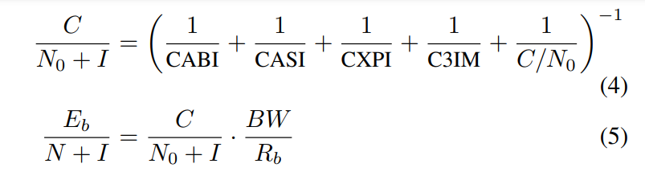

Slide 17

Problem Statement
Notes:
We consider a satellite with N fixed-pointing beams and Our objectve is to assign an average power and bandwidth to each of the N beams , such that the unmet system capacity (USC) is minimized

Slide 18
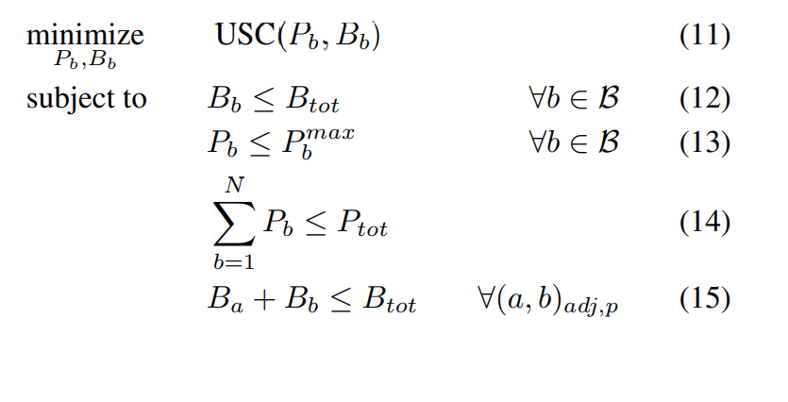

Slide 19
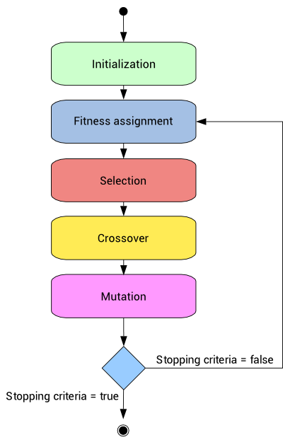
Genetic Algorithm
Notes:
Genetic Algorithms are the heuristic search and optimization techniques that mimic the process of natural evolution

Slide 20

GENETIC TERMS

Slide 21
Fitness Function
Evaluate given solution w.r.t optimum solution
Determines how fit a solution is
Notes:
Fitness Function (also known as the Evaluation Function) evaluates how close a given solution is to the optimum solution of the desired problem. It determines how fit a solution is
1. In genetic algorithms, each solution is generally represented as a string of binary numbers, known as a chromosome.
2. We have to test these solutions and come up with the best set of solutions to solve a given problem.
3. Each solution, therefore, needs to be awarded a score, to indicate how close it came to meeting the overall specification of the desired solution. This score is generated by applying the fitness function to the test, or results obtained from the tested solution.

Slide 22
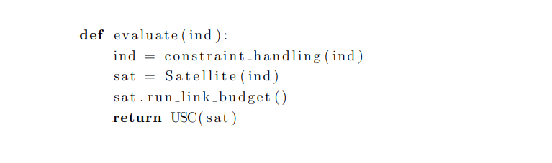
Our Fitness Function

Slide 23

Selection Selects the best, Discards the rest
Notes:
1. The process that determines which solutions are to be preserved and allowed to reproduce and which ones deserve to die out.
2. The primary objective of the selection operator is to emphasize the good solutions and eliminate the bad solutions in a population
while keeping the population size constant. “Selects the best, discards the rest”

Slide 24

Selection Operator
Tournament selection
Roulette wheel selection
Proportionate selection
Rank selection
Steady state selection, etc

Slide 25

Tournament Selection
Notes:
Tournament Selection:
In tournament selection several tournaments are played among a few individuals.
The individuals are chosen at random from the population.
The winner of each tournament is selected for next generation.
Selection pressure can be adjusted by changing the tournament size.

Slide 26
Crossover Operator
The crossover operator is used to create new solutions from the existing solutions available in the mating pool after applying selection operator.
This operator exchanges the gene information between the solutions in the mating pool.

Slide 27

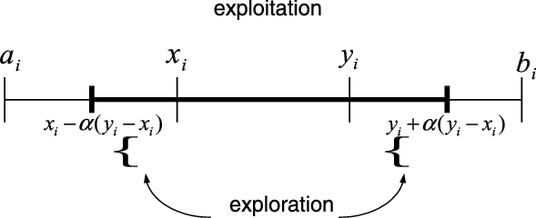
Blend Crossover
Notes:
Given the two parents x1 and x2 where x1 < x2, the blend crossover randomly selects a child in the range [ x1-α(x2-x1), x2+α(x2-x1)]
It is often suggested that a good choice of α is 0.5

Slide 28
Mutation Operator
Mutation is the occasional introduction of new features in to the solution strings of the population pool to maintain diversity in the population.
Though crossover has the main responsibility to search for the optimal solution, mutation is also used for this purpose.
Notes:
A mutation is defined as successful if the mutated offspring is better than the parent solution.

Slide 29
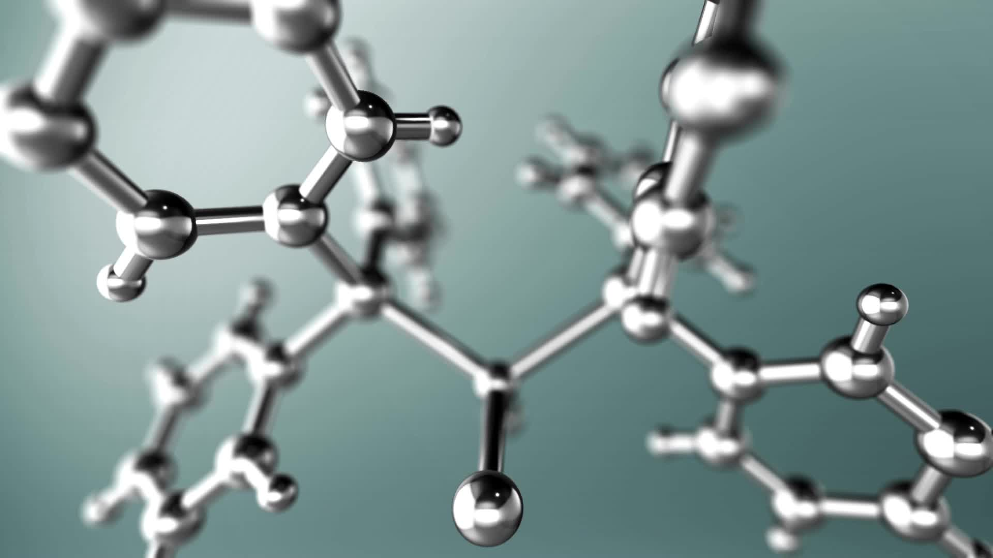
Uniform Mutation
Notes:
In uniform mutation we select a random gene(individual) from our chromosome (Population) ,
let’s say xi and assign a uniform random value to it. Let xi be within the range [ai,bi] then we assign U(ai,bi) to xi U(ai,bi) denotes a uniform random number from within the range [ai,bi].
Algorithm – 1. Select a random integer number i from [1,n] 2. Set xi to U(ai,bi).

Slide 30

Future Work
We are going to complete Genetic Algorithm to Solve this Optimization Problem. We are going to use DEAP python library to solve our problem

Slide 31
References
A Genetic Algorithm for Joint Power and Bandwidth Allocation in Multibeam Satellite Systems – Alex Paris (2019)
https://youtu.be/0iKgOahW5y0
http://deap.readthedocs.io/ - Deap Python Framework

Slide 32

THANK YOU

